Slide 1

Generations in the Workplace: How to Work Together

Slide 2
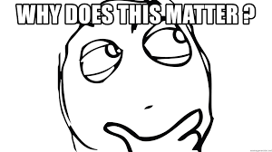
Background:
People in the United States are living longer than any generation before them. This means that individuals are working later in life than ever before. In your job you will find yourself interacting with co-workers that may be much older or much younger than you.
Purpose:
This training will give you a deeper understanding of different generational experiences and through this deeper understanding create a more collaborative working environment for everyone

Slide 3
Learning Objectives
After completing this training you will:
Be able to articulate the cultural influences and life experiences of a generation different from your own
Demonstrate how to work more collaboratively with a co-worker from a generation different from your own
Respond more empathetically to conflict with an individual from a generation different from your own.
Utilize the strengths of each generation to create a more positive and effective work culture.

Slide 4

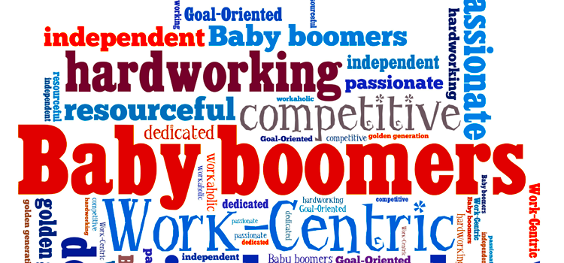
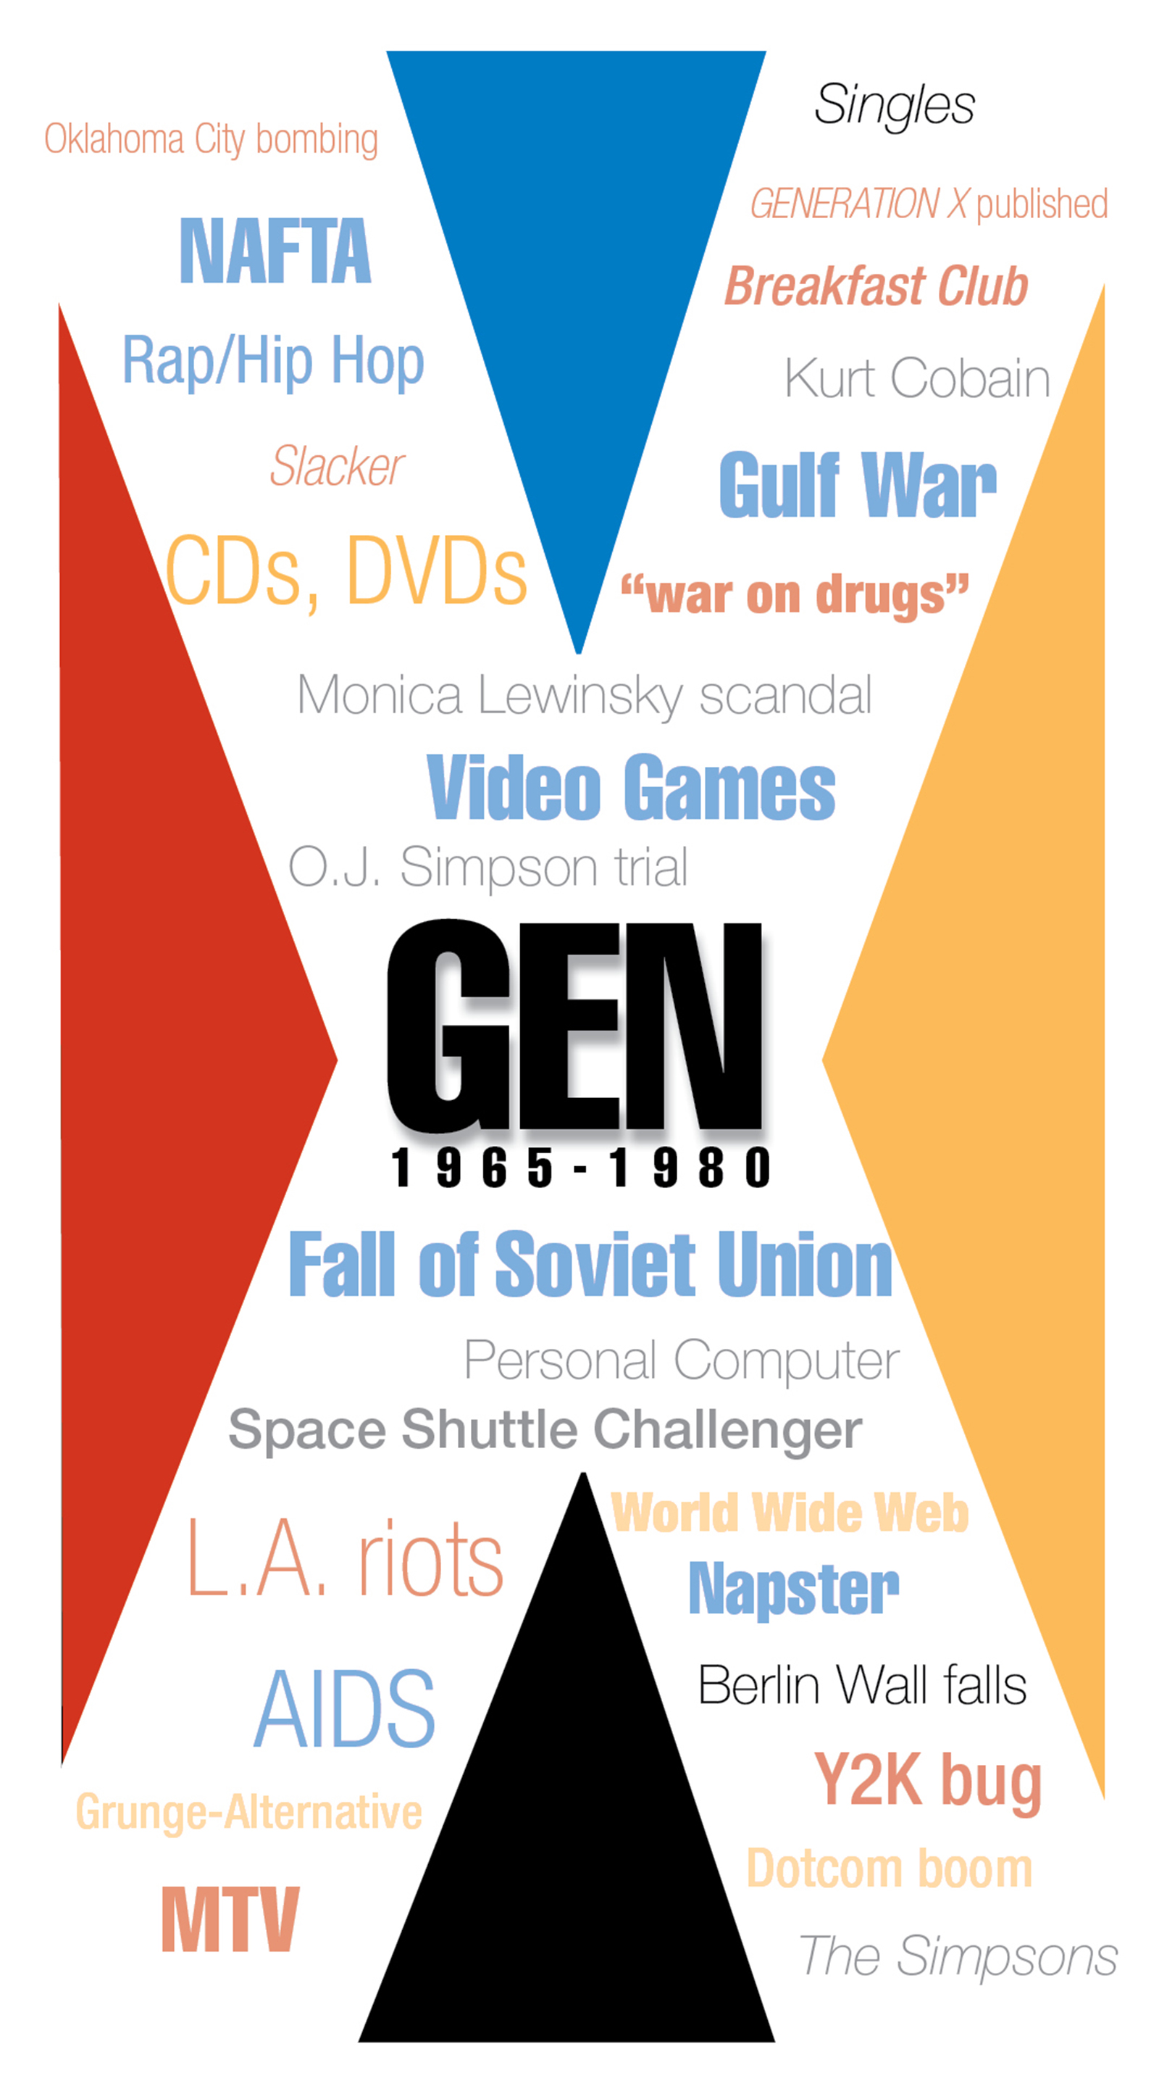
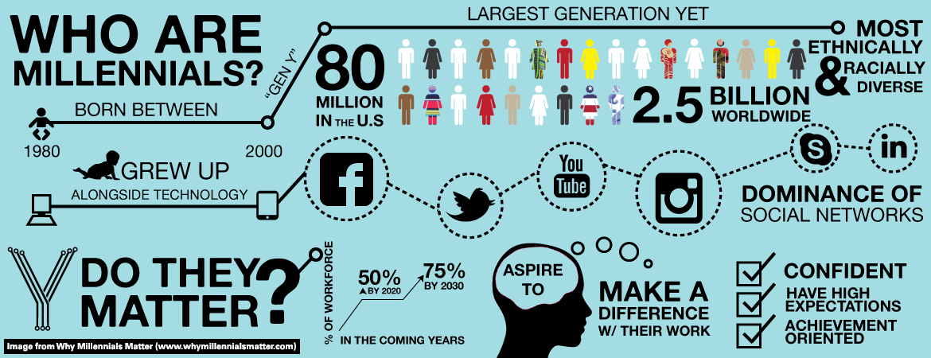
What is a Generation?
Generation Cohort Theory:
“A generation is defined as a group of individuals born and living contemporaneously who share common knowledge and experiences that affect their thoughts, attitudes, values, beliefs and behaviors”
(Clark, pg. 379 2017)

Slide 5
Why is this so important?
Employee Retention
Costly to recruit, hire, and train new employees
Research on Generational Differences is mixed by there is evidence that these differences in experience, values and beliefs do impact the workplace
Without empathy and understanding between the generations, conflict can get in the way!
Becton, J. B., Walker, H. J., Jones-Farmer, A. (2014). Generational differences in workplace behavior. Journal of Applied Social Psychology, 44, 175-189.

Slide 6
Generations Most Common In the Workplace
Name: | Born:
Baby Boomers | 1946 - 1970
Generation Jones (late Boomers) | 1953 - 1969
Gen X | 1970 – 1980
Oregon Trail/MTV Generation (overlapping subset) | 1974 – 1983
Millennials (aka Gen Y) | 1980 – 2000
Gen Z or ? | 2000 to ?
*The birth dates vary depending on your source
Clark, K. R. (2017). Managing Multiple Generations in the Workplace. Radiologic Technology, 88, 379-398.

Slide 7
“Talkin’ ‘bout My Generation”
Cross the Line Activity

Slide 8

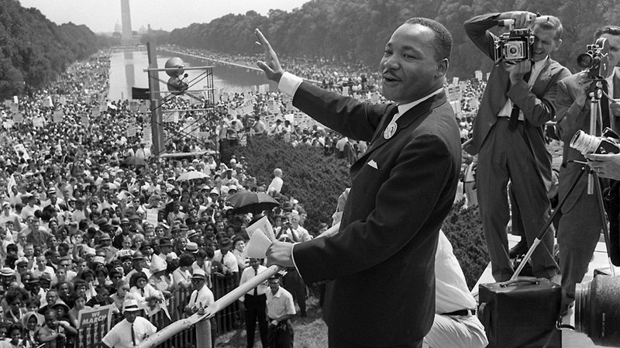

Boomers – Historical Perspective
Women’s Rights movement
Civil Rights movement
Disability Rights movement
Growing numbers of women entering the workplace
Higher divorce rate & 2nd marriages than parents
Rock & Roll
Hippies and drug culture
Huge Growth in Healthcare and longer lifespans (example: Polio vaccine)
Clark, K. R. (2017). Managing Multiple Generations in the Workplace. Radiologic Technology, 88, 379-398.

Slide 9
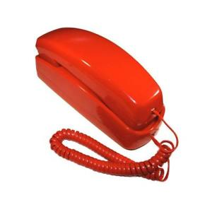
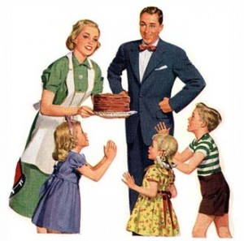
Boomers Grew Up With:
Post WWII—huge baby boom, large families
Moved out of parent’s house at age 18 or after college
Typically married at age 18 to early 20’s
Emergence of the strongest middle class in history (GI-Bill)
Hi-fi’s and stereos (no personal computers)
Analog phones (with cords!!)
Grew up without seatbelts in cars
Started working age 14 (min wage $3.65-1973)
Clark, K. R. (2017). Managing Multiple Generations in the Workplace. Radiologic Technology, 88, 379-398.

Slide 10
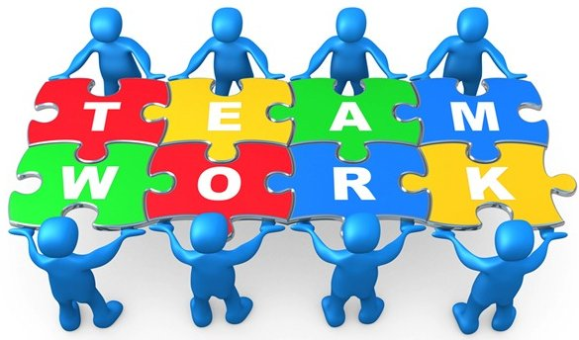
Boomer Worker Characteristics
Have a strong work ethic and will work long hours. They tend to be defined by their careers.
Boomers are good a collaboration and are adept and working closely with peers and prefer team projects
Financial success is very important to this generation and they enjoy a more affluent lifestyle
They balance their desire for financial success with a motivation toward organizations who have a more democratic style or humanitarian mission.
Weston (2001). Coaching Generations in the Workplace. Nursing Administration Quarterly, 88, 11-21.

Slide 11
Inspiring and Motivating Baby Boomers
Communication
Valuing Them
Supervision
Face to face
Treat them as an equal
Democratic (not hierarchical)
Flexible Work Schedules
Allow for Flexible Work Schedules
Leverage their knowledge and Experience
Offer opportunities for collaboration and teamwork
Weston (2001). Coaching Generations in the Workplace. Nursing Administration Quarterly, 88, 11-21.

Slide 12
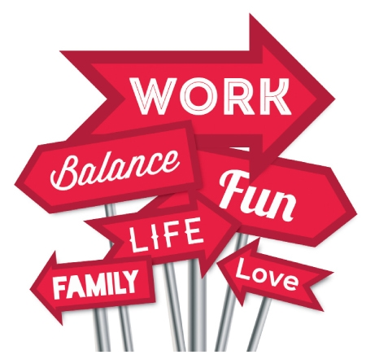
If You Want to Recruit / Retain Baby Boomers
According to a 2009 Pew Research Survey,
“…the typical boomer does not believe old age starts until 72” (Gilbaldi, 2013 pg. 50)
“68% [baby boomers] deemed that feeling useful and productive was an important factor” (Gilbaldi, 2013 pg. 51)
Boomers are the largest cohort heading toward retirement, many are asking for “working retirements”
Consider Phased Retirement Options
Gibaldi, C.P. (2013). Changing the trends of retirement: Baby Boomers leading the charge. Review of Business, 34, 50-57.

Slide 13
Face-to-Face Time with A Boomer: Activity
Find a Baby Boomer to Pair Up with and ask the following questions:
What I miss most about life when I was a kid?
If you could offer advice to someone starting there work or career what would it be?
What experience, in your life, shaped you or made you who you are today?
BOOMERS BORN 1946-1968

Slide 14
Generation X

Slide 15

Generation X
Gen X born: 1970 – early 1980’s
Grew up during pop culture of the '70s and 80s

Slide 16
Gen Xers
In 2018 they will range in age from 38 – 48 yrs.
41 - 65 million of them (depends on who you ask)
Compare to 77 million Baby Boomers and 83 million Millennials
Becton, J. B., Walker, H. J., Jones-Farmer, A. (2014). Generational differences in workplace behavior. Journal of Applied Social Psychology, 44, 175-189.

Slide 17


Gen X– Historical Perspective
Roe V. Wade 1973
Watergate 1974
AIDS Epidemic 1980s
Rodney King 1991
Columbine Shooting 1999
9/11—2001
Dot Com Boom 1990s-early 2000s
Clark, K. R. (2017). Managing Multiple Generations in the Workplace. Radiologic Technology, 88, 379-398.

Slide 18

Gen X (smallest cohort)
The birth control pill, introduced in the early 1960s
Declining birth rates evidenced in this generation.
During this Generation the U.S., increased immigration rates
Generation X an ethnically and culturally diverse demographic cohort.
Clark, K. R. (2017). Managing Multiple Generations in the Workplace. Radiologic Technology, 88, 379-398.

Slide 19


Gen X
Gen Xers are a highly educated generation
29% obtaining a bachelor’s degree or higher (6% more than the previous cohort).
Exerted caution around starting families, preferring to ensure there would be 2 parents and financial stability due to high rate of divorce their parents (and they as children) experienced
Clark, K. R. (2017). Managing Multiple Generations in the Workplace. Radiologic Technology, 88, 379-398.

Slide 20
Gen X
This generation straddled analog and internet—huge technology boom
They grew up seeing the economy go from strong to far less secure
Huge dot com company boom
with companies downsizing
jobs exported
inflation
Huge College Loan Debt
Becton, J. B., Walker, H. J., Jones-Farmer, A. (2014). Generational differences in workplace behavior. Journal of Applied Social Psychology, 44, 175-189.

Slide 21

Gen Xers are Independent Thinkers
Huge boom in double income households--latchkey kids.
Divorce rate rose in the 1970s
First to adopt and innovate new technologies
Becton, J. B., Walker, H. J., Jones-Farmer, A. (2014). Generational differences in workplace behavior. Journal of Applied Social Psychology, 44, 175-189.

Slide 22

Gen X’s as Consumers
82% (high percentage) are home owners
74% use the Internet for banking, 81% have made purchases online.
62% read newspapers, 48% listen to radio and read magazines, and 45% regularly consume TV programming online.
95% have a page on Facebook and 25% regularly post to Twitter
Becton, J. B., Walker, H. J., Jones-Farmer, A. (2014). Generational differences in workplace behavior. Journal of Applied Social Psychology, 44, 175-189.

Slide 23
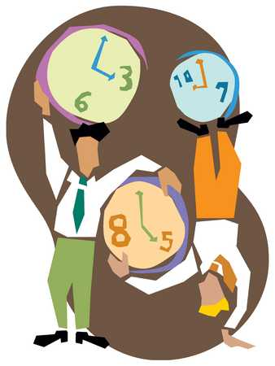
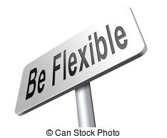
Gen Xers as Employees
Gen X respondents ranked workplace flexibility as the most important perk
(21%) and are more likely to walk away from their current job if flexibility isn’t available.
66% of Gen X women
55% of Gen X men
Almost a quarter have been with the same employer for fifteen years or longer.
Gen Xers want a more casual supervision style from a boss who invests in them personally
Work-life balance is key to Gen-Xers
Clark, K. R. (2017). Managing Multiple Generations in the Workplace. Radiologic Technology, 88, 379-398.

Slide 24
Inspiring and Motivating Gen Xers
Communication
Valuing Them
Supervision
Less Formal/Casual Communication
Allow them time to figure things out independently and then process solutions
Supervisor who cares about their personal goals and ambitions
Seek fun and innovative supervisors who trust them and value their independence
Create opportunities for career advancement
Reward them with free time and flexible work schedules
Create a diverse staff team and work environment
Clark, K. R. (2017). Managing Multiple Generations in the Workplace. Radiologic Technology, 88, 379-398.

Slide 25
Break-Time With A Gen Xer
Since Gen Xers prefer a more casual approach to work time, let’s join them! The Trainer will set out some special snacks, take yours to a casual place inside or outside the classroom. Spend some time chatting about below:
What do you love about your life outside of work?
What are your personal goals and ambitions?
Tell me a little about the best job you ever had or an ideal job you really want to have?
Gen Xers born 1969-1979

Slide 26
Millennials or Gen Y

Slide 27
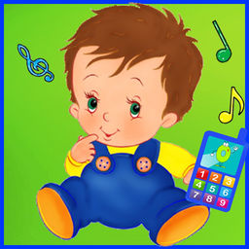
Millennials (born between 1980 – 2000)
They are the most technologically advances generation cohort
They are predicted to occupy almost half the working population by 2020.
First Generation born into a digitally connected and globalized world.
Clark, K. R. (2017). Managing Multiple Generations in the Workplace. Radiologic Technology, 88, 379-398.

Slide 28

Millennials are the most racially & ethnically diverse adult generation:
57% are caucasian
21% are Latino
13% are black
6% are Asian.
Each older generation is less diverse. Caucasians = 61% of Generation X, 72% of Baby Boomers and 78% of the Silent generation.
Or racially mixed
Clark, K. R. (2017). Managing Multiple Generations in the Workplace. Radiologic Technology, 88, 379-398.

Slide 29
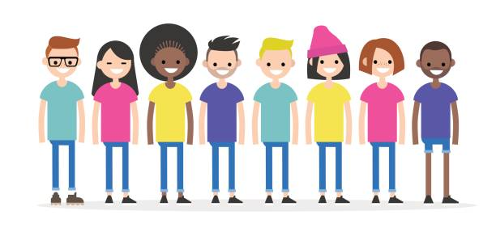
Why are Millennials getting so much attention now?
Largest generation in the U.S. workforce
Fastest-growing generation of customers in the marketplace
Different attitudes towards employment, sales, and marketing; and
Challenging conventional strategies and approaches.
Becton, J. B., Walker, H. J., Jones-Farmer, A. (2014). Generational differences in workplace behavior. Journal of Applied Social Psychology, 44, 175-189.

Slide 30
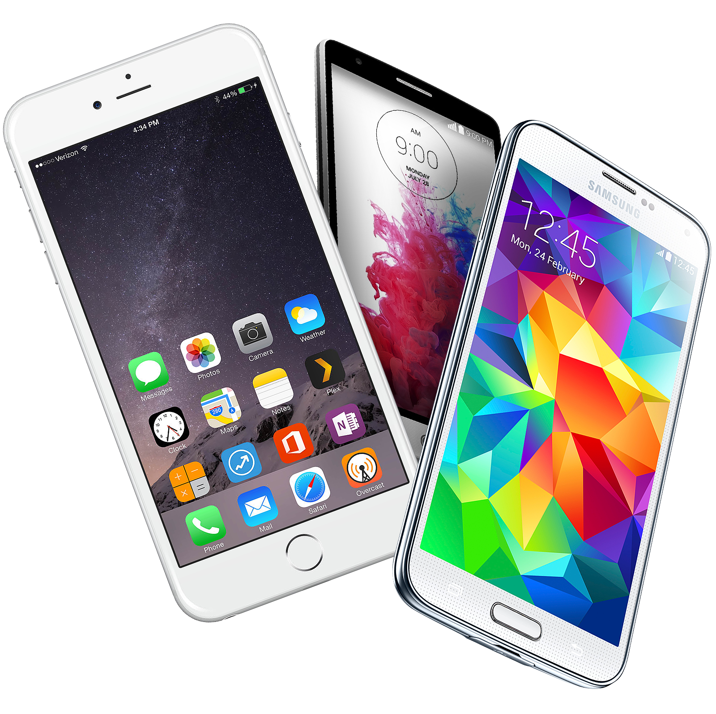
Millennials– Historical Perspective
The Rise of Social Media
Cell phones/Smart Phones
War (Iraq/Afghanistan)
Massive College Debt
Housing Collapse (depression)
Dating Online
Increase in School/Mass Shootings
First African American President
Clark, K. R. (2017). Managing Multiple Generations in the Workplace. Radiologic Technology, 88, 379-398.

Slide 31
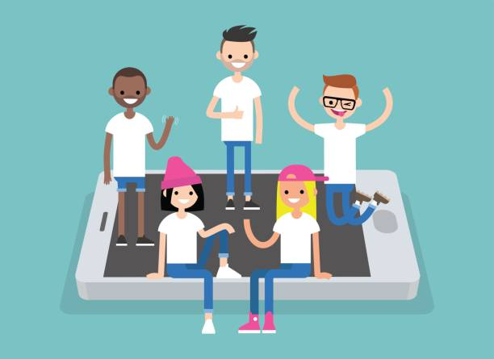
Millennials are:
Extremely open-minded and excited about their career opportunities
Goal-oriented and great multi-taskers
Skilled collaborators who crave open, honest relationships with managers
Desire to genuinely enjoy their jobs, as well as the people they work with
Tech-savvy, with an innate understanding of how to leverage technology solutions
Rely heavily on digital means of communication
Clark, K. R. (2017). Managing Multiple Generations in the Workplace. Radiologic Technology, 88, 379-398.

Slide 32

Millennials
Millennials started entering the work force after the 2008 crash and have faced bleak prospects for professional advancement and many anticipate staying at any given job for less than three years.
Lawson, M. (2017). Shifting to the next generation workplace. Public Management, 14-18.

Slide 33
Inspiring and Motivating Millennial
Communication
Valuing Them
Supervision
Text, IM, Snapchat, Social Media (other new communication innovation)
Prefer trainings virtually and connection to information virtually
Connect them with how they are making an impact (one world, community, etc)
Foster collaboration and allow them to multi-task roles and responsibilities
Leverage their technical saavy
Coach and mentor them
Think globally help them connect to the bigger picture
Lawson, M. (2017). Shifting to the next generation workplace. Public Management, 14-18.

Slide 34
Digital Connection With A Millennial
Guess what? It’s ok, for this exercise, to use your cell phone. Find a millennial and talk together about how you want to digitally communicate. Maybe text, email, snapchat or other confidential medium. If you don’t have a cell phone handy you can chose to a one-to-one conversation. Chat about:
Where do you want to travel in your life?
What is their dream job?
How do you want to make a difference in the world?

Slide 35
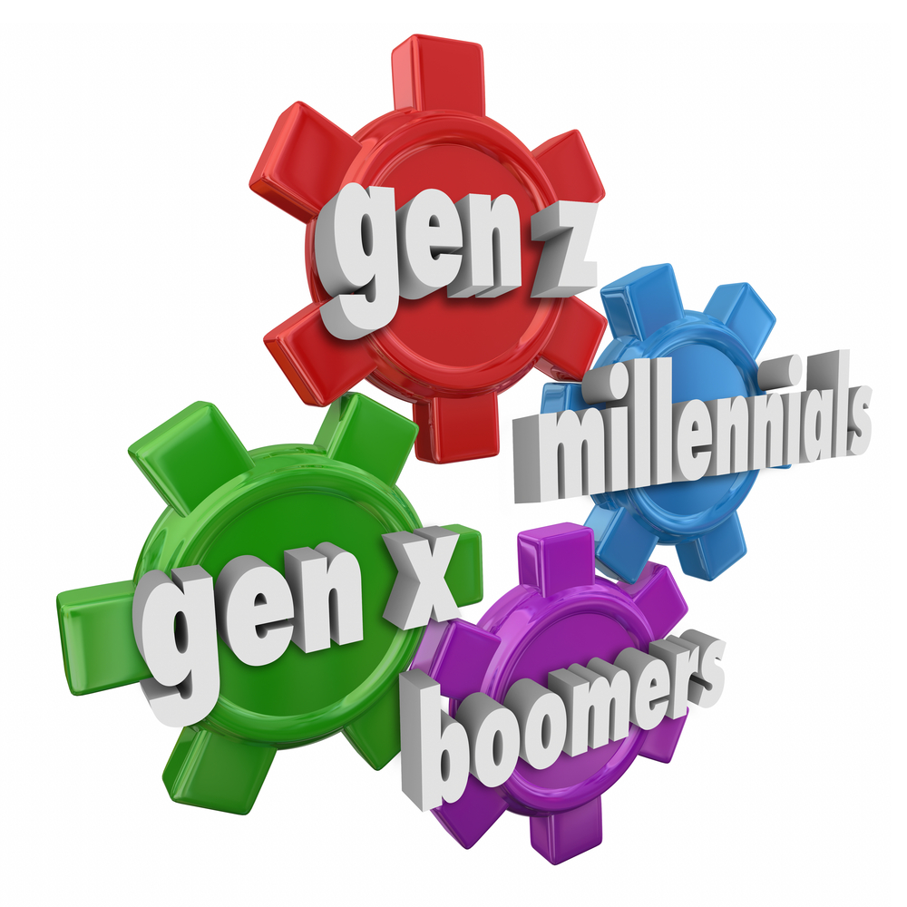
Creating A Multi-Generational Work Environment

Slide 36
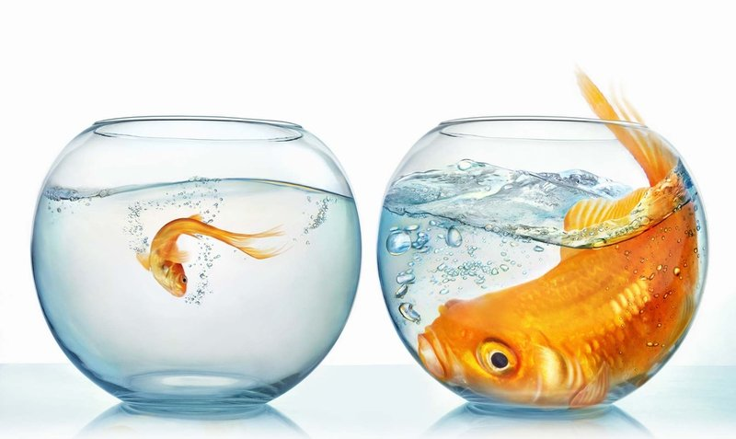
Generational Fishbowl Activity

Slide 37
Multi-Generational Work Environment
Foster a work environment that respects and values differences— rather than downplaying or punishing them.
Remember the research is still showing that individual differences outweigh generational differences. We need to take generational cohort experiences into consideration but policy should not be developed SOLELY on these generalized differences
Becton, J. B., Walker, H. J., Jones-Farmer, A. (2014). Generational differences in workplace behavior. Journal of Applied Social Psychology, 44, 175-189.

Slide 38
 | Boomers | Gen X | Millennials
Communication | Face-to-Face or Phone | Voicemail or email | IM or Text
Acknowledgement | Show personal appreciation | Reward with free time or opportunities | Awards and Certificates
How to Show Respect | Treat them as equals | Support training & growth | Value civic duty
Supervision Style That Works Best | Democratic not hierarchical | Give them freedom | Be collaborative
How to Motivate | Tell them “we need you” because | Think globally | Offer coaching & support
How they work best with teams | They are motivated to collaborate but needs to know how this fits the mission of the agency | Give them individual assignments and don’t micromanage | Provide flexibility in assignments and participation
Feedback | Ask for and hear their input | Give timely and specific feedback | Tell them how they make a difference
Professional Developmental Needs: | Offer flexible schedules or phased retirement | Care about their personal goals | Provide the latest technology
What they want from the Org. | Leverage their knowledge | Make it fun | Promote volunteerism
They value | Teamwork | Diversity | Technical advancements

Slide 39
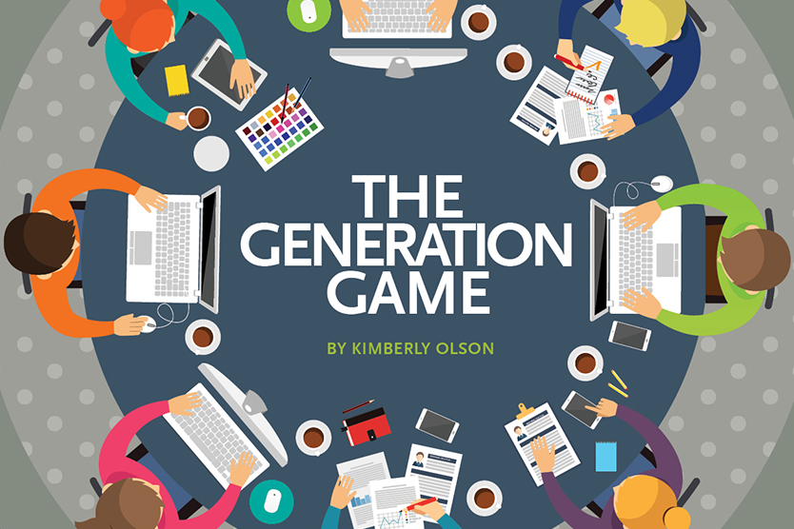
Employers Should Consider
Formal or informal organization-wide mentoring program. Nurture, nurture, nurture!
Team-building activities whenever a new person is hired into the team
MINIMIZE criticism of other generations

Slide 40
References
Becton, J. B., Walker, H. J., Jones-Farmer, A. (2014). Generational
differences in workplace behavior. Journal of Applied Social
Psychology, 44, 175-189
Clark, K. R. (2017). Managing Multiple Generations in the
Workplace. Radiologic Technology, 88, 379-398.
Gibaldi, C.P. (2013). Changing the trends of retirement: Baby Boomers
leading the charge. Review of Business, 34, 50-57.
Lawson, M. (2017). Shifting to the next generation workplace. Public
Management, 14-18.
Weston (2001). Coaching Generations in the Workplace. Nursing
Administration Quarterly, 88, 11-21.

Slide 41

Questions Break! What are your questions for me?
Sarah Blanchette
Residential Services Training
Program Manager
360-407-1540
BlancSR@dshs.wa.gov

